Slide 1
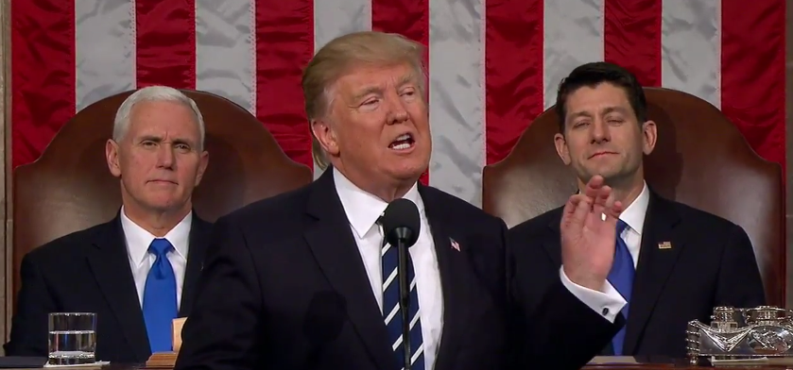
Federal Infrastructure Plan: March 7, 2018
Serge Phillips, MnDOT Federal Relations Manager

Slide 2
Topics
FY 2018 Federal Spending Update
Trump Administration Infrastructure Plan
Funding
Leverage
Existing Program Changes

Slide 3
FY2018 Federal Spending Update
Current Funding Expires March 23, 2018
Spending Caps for FY2018 & 2019 – Big Increases
Transportation and Housing Subcommittee
Discretionary Grant Programs (TIGER, New Starts, Rail)
$10 billion per year for “Infrastructure”
President’s Budget for FY2019 includes Infrastructure Plan

Slide 4
Trump Administration Infrastructure Plan: Funding
$200 billion in federal infrastructure funding - to leverage $1.5 trillion over the next 10 years.
$200 Billion Breakdown
Incentive Grants to States/Local Governments $100 Bill.
Infrastructure Assistance for Rural Areas $ 50 Bill.
Transformative Projects (Competitive Large-scale projects) $ 20 Bill.
Federal Credit Programs $14 Bill.
Other Loan endowments & interest payback assistance $16 Bill. Total: $200 Bill.

Slide 5
Trump Administration Infrastructure Plan: Funding
Incentive Grants: $100 billion – USDOT/EPA/Corps of Engineers
Competitive awards to spur additional investment, capped at 20% of project cost
Rural Areas: $50 billion – $ 40 billion to states via formula
$1.2 billion for Minnesota over 10 years
Fast start-up: “Placeholder” for $40 billion in FY 2019
Transformative Projects: $20 billion – Commerce
Competitive awards for projects without private sector money
i. Demonstration track – capped at 30%
ii. Planning Track – capped at 50%
iii. Capital Construction Track – capped at 80%

Slide 6
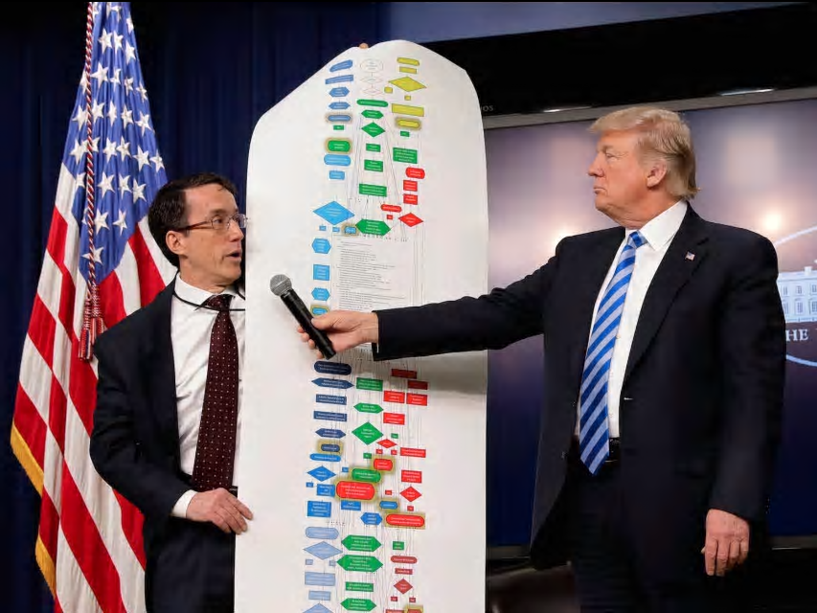
Trump Administration Infrastructure Plan: Funding
Program Cuts to Modal Programs?
No mention of Highway Trust Fund
D.J. Gribbin
Devolution?

Slide 7
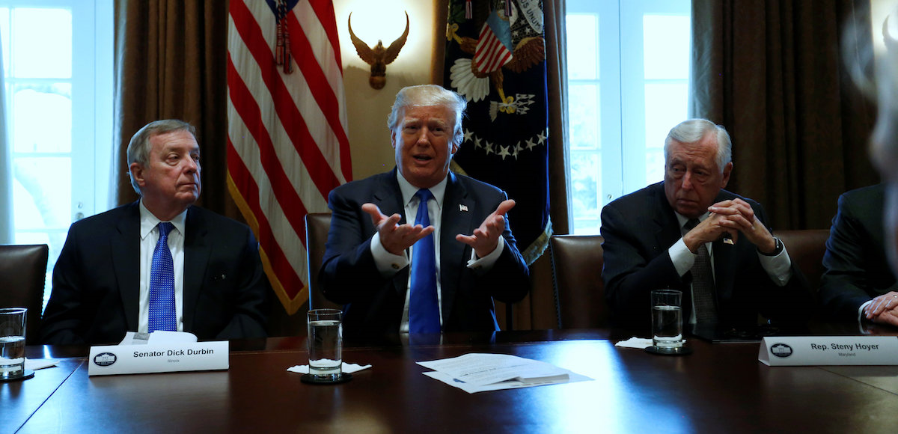
Trump Administration Infrastructure Plan: Leverage
Federal Credit Programs: $14 Billion into $1.5 Trillion

Slide 8
Trump Administration Infrastructure Plan: Program Changes
Highways:
Toll Existing Interstate
Commercialize Interstate Rest Areas
Project Delivery Provisions
Mass Transit
Value Capture Mandate
P3s

Slide 9
Thank you!
Serge Phillips
Sergius.phillips@state.mn.us
651-366-3075

